Slide 1

ONCHAIN FUTMINNA
ONBOARDING

Slide 2
Demystifying
The Technology
What is Blockchain? Why Does It Matter? What's the Opportunity?

Slide 3




What is Blockchain?
Blockchain ≠ Crypto
Decentralized Ledger
Blockchain is the OS-level infrastructure. Cryptocurrency is just one app built on top of it.
Identical copies of the transaction record exist across thousands of global network nodes.
Immutability
Distributed Trust
Once cryptographically verified and added to the chain, records can never be altered or deleted.
Eliminates single points of failure. No central authority controls or can corrupt the data.
BLOCKCHAIN CLUB · FUTMINNA

Slide 4
The Four Verified Blockchain Networks
PUBLIC
PRIVATE
CONSORTIUM
HYBRID
Permissionless
Permissioned
Multi-governed
Best of Both
Completely open. Anyone can read, write, and audit.
Fully closed. Access strictly controlled by one entity.
Governed by a pre-selected group of institutions.
Private data controls + public transparency proofs.
EXAMPLES
EXAMPLES
EXAMPLES
EXAMPLES
Bitcoin · Ethereum · Sui
Hyperledger Fabric · R3 Corda
GSBN · B3i Insurance Network
XinFin (XDC) · Dragonchain
BLOCKCHAIN CLUB · FUTMINNA

Slide 5


Why You Should Care
The Merging of Frontiers
01
Blockchain + AI
Public ledgers record AI training logs, data usage rights, and multi-agent communication for absolute auditability.
02
AI Trust & Provenance
Smart contracts enforce data rights for AI agents. Every model decision becomes traceable and auditable on-chain.
03
Robotics Integration
Hardware platforms execute tasks via decentralized smart contracts — not risky centralized servers. (e.g., Sui for Robotics)
04
IoT Telemetry & Security
Connected sensors stream encrypted operational data to immutable chains, preventing data spoofing and manipulation.
BLOCKCHAIN CLUB · FUTMINNA

Slide 6



Real-Life Use Cases; Beyond the Coin
Supply Chain & Food Safety
Digital Identity & Governance
Global Institutional Finance
Walmart & IBM Food Trust
Estonia X-Road Infrastructure
BlackRock BUIDL Tokenized Fund
7 days → 2.2 sec
100%
24 / 7 / 365
traceback time
forgery eliminated
settlement speed
Traces food from farm to shelf. Drastically cuts recall response time and prevents massive product waste.
Powers national digital IDs, tamper-proof health records, and secure e-voting. No paper dependency.
Tokenizes US Treasury bonds on public blockchain. Instant global financial settlement without legacy delays.
BLOCKCHAIN CLUB · FUTMINNA

Slide 7







05 / CAREERS
Career Opportunities; The Open Invitation
Development
Design
Marketing
Frontend, Backend & Full-Stack. Build web interfaces, APIs, and smart contract integrations.
UI/UX Designers. Transform complex crypto workflows into seamless user experiences.
Growth Hackers & Brand Strategists. Drive protocol adoption and build sustainable user bases.
Community Management
Content Creation
Research
Moderators & Ops Leads. Nurture global engagement and maintain healthy communities.
Writers & Video Creators. Simplify technical docs into high-impact educational assets.
Data Analysts & Tokenomics Designers. Audit protocols and design economic models.
BLOCKCHAIN CLUB · FUTMINNA

Slide 8
Join the Movement.
The future is decentralized; and it's being built right now.
Building the next generation of Web3 engineers.

Slide 9
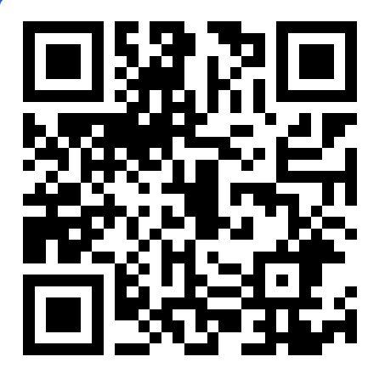
GAME TIME
Join at
Slido.com
#3115 085

